Slide 1
History of Internet

Slide 2
What will you learn?
Internet
Computer Introduction
Web Basics
Web Design
Web Development

Slide 3
What you have to do?
Quiz
Assignements
Final Paper
Présentation & Class Participation

Slide 4
What is Computer?
Computer is an electronic device which
Accept data
Process data
& Store data for future use
A computer consists of hardware and software
Hardware are physical parts of computer
Software are the programs that are used to process input to output directed by software.

Slide 5
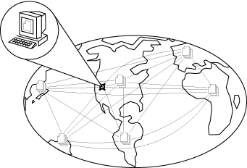
What is internet?
The Internet is made up of thousands of computer networks that are connected (networked) to each other. These connected computer networks are using the communication method called TCP/IP.
A network of networks, joining many government, university and private computers together and providing an infrastructure for the use of E-mail, bulletin boards, file archives, hypertext documents, databases and other computational resources

Slide 6
Information Technology
By using high speed communication links to spread information from one place to another that is called information technology.
Information technology make the world global
Digital Convergence

Slide 7
Information Technology
Applications of information technology
Artificial intelligence
Web based applications
Ecommerce
Distributed Computing
Multimedia/Hypermedia

Slide 8
Introduction
The Internet has revolutionized the computer and communications world like nothing before.
Internet is :
worldwide broadcasting capability,
a mechanism for information distribution,
and a medium for collaboration
interaction between individuals and their computers without regard for geographic location.

Slide 9
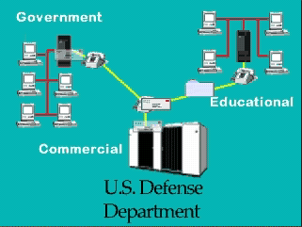
Three Major Players in Internet History

Slide 10
Brief History of Internet
Internet is a network of interconnected computers that is now global
Internet born in 1969 - called ARPANET
1969 ARPANET was connection of computers

Slide 11
State of computers?
What was the state of computers in the late 1960s and early 1970s?

Slide 12
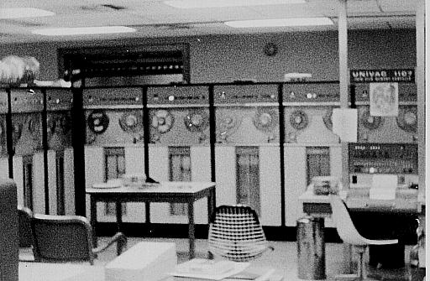
Computers late 60s & 70s
No Personal Computers – all large mainframe computers in late 60s
Mid 1970s – initial personal computers
Altair: Box with blinking lights
Late 1970s – Apple 2, first usable PC

Slide 13
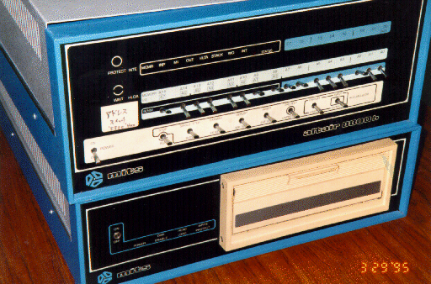
Personal Computing?
Just a box with blinking lights
Not where Networking/ Internet was being developed

Slide 14
Internet 1957
During the Cold War, on October 4, 1957 the Soviet Union (now Russia) quietly launched its first spacecraft satellite called Sputnik into orbit.
This launch challenged the United States Department of Defense to put a high priority on research and projects in science and technology and created an agency called ARPA (Advanced Research Projects Agency).

Slide 15
Internet 1961
The United States Air Force commissioned the Rand Corporation to proceed with a research project that consisted of protection and transfer of vital information in case of an attack in a nuclear war.

Slide 16
Internet 1971
ARPANET was connecting 23 mini-computers in different universities and institutes in the United States, and was using the network control protocol (NCP) to transfer data.

Slide 17
Internet - 1970s
1972 - Telnet developed as a way to connect to remote computer
1972 – Email introduced
1977 - U. Wisconsin has first “large” Email system - 100 users
1973 - ARPANET goes international
1973 - File Transfer Protocol (FTP) established

Slide 18
State of computers?
What was the state of computers in the early 1980s?

Slide 19
Computers 1980s
1981 – IBM PC
1984 – Apple Macintosh
1986 – Modem becomes option on PCs

Slide 20
Internet - 1980s
1984 - Domain Name Server introduced
allows naming of hosts, no longer numeric
1986 - NSFNET created
in 1990, becomes backbone of modern Internet when ARPANET is decommissioned
Completely privatized by 1995
56 K interconnection initially, increased rapidly

Slide 21
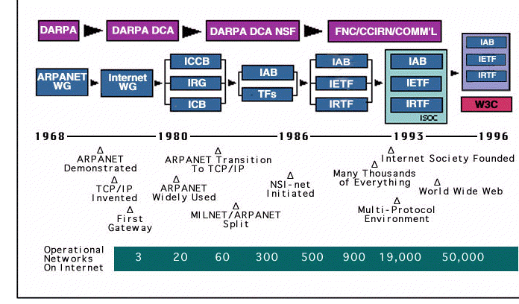
Internet Timeline
NSF Net

Slide 22
Internet 1990s
1991 - Tim Berners-Lee releases World Wide Web!
TBL is computer programmer at CERN, a physics lab in Europe (new book Weaving the Web by TBL)
1993 - Mosaic (becomes Netscape) designed by graduate students at University of Illinois
first point-and-click browser
later developed into Netscape Navigator
These are the two most significant events in the formation of the WWW

Slide 23
Internet 1994
Internet Search Engines Started: Yahoo
Excite
Infoseek

Slide 24
World Wide Web
Via Internet, computers can contact each other
Public files on computers can be read by remote user
usually HyperText Markup Language (.html)
URL - Universal Resource Locator - is name of file on a remote computer
http://www.msu.edu/~urquhar5/tour/active.html

Slide 25
HTTP
World Wide Web uses HTTP Servers, better known as web server
Receive HTTP type request and send requested file in packets

Slide 26
Web Browsers
Mosaic (1993) was first point-and-click browser
Web browsers are the software we use to view web pages
Netscape Navigator and Internet Explorer are most popular
Netscape Navigator was original, but Microsoft leveraged IE on market

Slide 27
State of computers?
What was the state of computers in the early to mid 1990s?

Slide 28
Universal Resource Locator
http://www.msu.edu/~urquhar5/tour/active.html
http://
identifies type
of transfer
www.msu.edu
Domain Name -
name of remote computer

Slide 29
21st Century – File Sharing
Internet allowed sharing of simple information
FTP was initial file sharing system, but a bit hard to use
WWW advanced type of info allowed, but not designed for file-sharing
Napster, KaZaA, Morpheus and LimeWire are file-sharing.

Slide 30
What is WWW?
Via Internet, computers can contact each other
Public files on computers can be read by remote user
usually HyperText Markup Language (.html)
HTTP - HyperText Transfer Protocol
URL - Universal Resource Locator - is name of file on a remote computer
http://www.msu.edu/~urquhar5/tour/active.html

Slide 31
How to make a web page
Define the two basic steps required in making a web page.

Slide 32
Two Basic Steps
Create an HTML File
Upload file to server
Saving to P: drive eliminates this step

Slide 33
.html
Web documents are text files with .html extension
These text files have HTML “tags” in them

Slide 34
File Transfer Protocol
FTP Program (also called FTP client) used to transfer files from your computer to your public web directory housed on the MSU computers
WS_FTP LE is a good, free FTP program
In MSU Labs, can directly save stuff in your AFS space, on the P: drive, in the web directory

